Slide 1
Filters – Part B
Linear Circuit Analysis II
EECE 202 – Spring 2025

Slide 2
Announcement
Midterm during week 8
PD 1 Voice Over PPT due in Week 10

Slide 3
Recap
Filters
Filter Type
Transfer function of a filter
Cutoff frequency
New Material
Transfer function of LP, BP, and HP filter

Slide 4
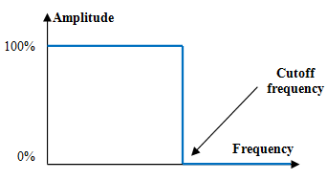
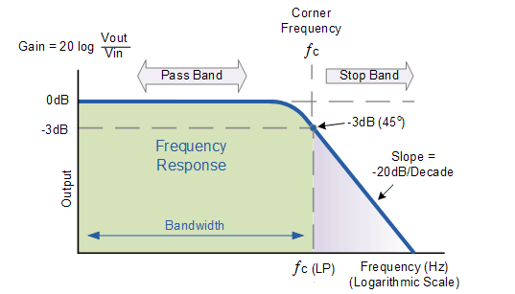
Low Pass Filter
The Low pass filter passes signals with frequencies below a certain value (f_{c}), and blocks frequencies above this value. This value (f_{c}) as shown in the figure (shows ideal filter) is called the cutoff frequency.
The characteristic shown in the figure represents the real response of the low pass filter, where the signal at the cutoff frequency (f_{c}) is attenuated to 70.7% (-3 dB) of its original amplitude.
The frequencies below this f_{c} is called “Pass Band”, and the frequencies above the f_{c} is called the “Stop Band”.

Slide 5
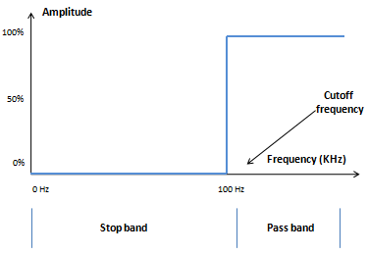
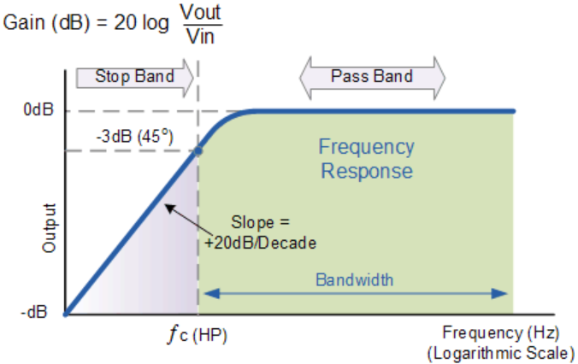
High pass filter
The High pass filter passes signals with frequencies above a certain value (f_{c}), and blocks frequencies below this value. This value (f_{c}) as shown in the figure (shows ideal filter) is called the cutoff frequency.
The characteristic shown in the figure represents the real response of the high pass filter, where the signal at the cutoff frequency (f_{c}) is attenuated to 70.7% (-3 dB) of its original amplitude.
The frequencies above this f_{c} is called “Pass Band”, and the frequencies below the f_{c} is called the “Stop Band”.

Slide 6
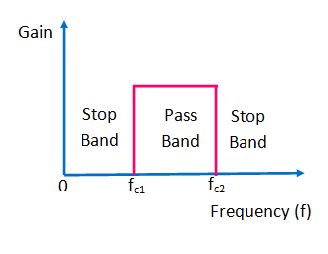
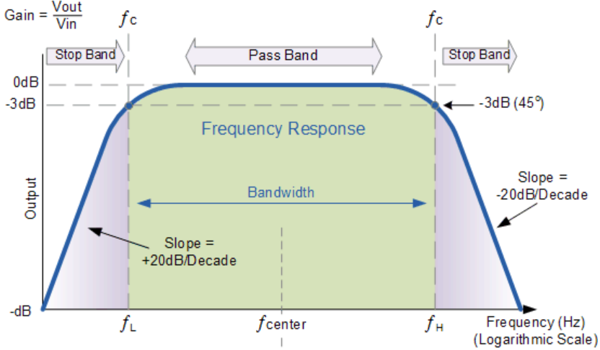
Bandpass Filter
The Band pass filter passes signals with frequencies between certain values (f_{c1}, f_{c2}), and blocks frequencies outside these values. These values (f_{c1}, f_{c2}) as shown in the figure (shows ideal filter) is called the cutoff frequencies.
The characteristic shown in the figure represents the real response of the band pass filter, where the signal at the cutoff frequency (f_{c1} and f_{c2}) are attenuated to 70.7% (-3 dB) of its original amplitude.
The frequencies in between these f_{c1} and f_{c2} are called “Pass Band”, and the frequencies outside the f_{c1} and f_{c2} are called the “Stop Band”.

Slide 7
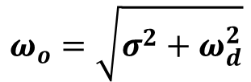

High Pass Filter (HPF)
The opposite of the low-pass is the high-pass filter, which rejects signals below its cutoff frequency.
The poles of the TF are : P_{1,2} = -σ ± j$ω$_{d}
$ω$₀: is the magnitude of pole frequency like in BP filter, and σ is the real part of the pole frequency
$$ω_{o}=\sqrt{σ^{2}+ω_{d}^{2}}$$
The peak frequency is :

Slide 8
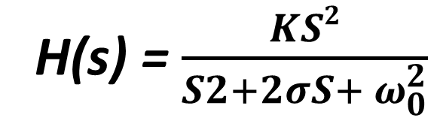
SALMAN
High Pass Filter (HPF)
The opposite of the low-pass is the high-pass filter, which rejects signals below its cutoff frequency.
H(s) = $\frac{KS2}{S2+2σS+ ω_{0}^{2}}$
The poles of the TF are : P_{1,2} = -σ ± j$ω$_{d}
$ω$₀: is the magnitude of pole frequency like in BP filter, and σ is the real part of the pole frequency
$$ω_{o}=\sqrt{σ^{2}+ω_{d}^{2}}$$
The peak frequency is :

Slide 9
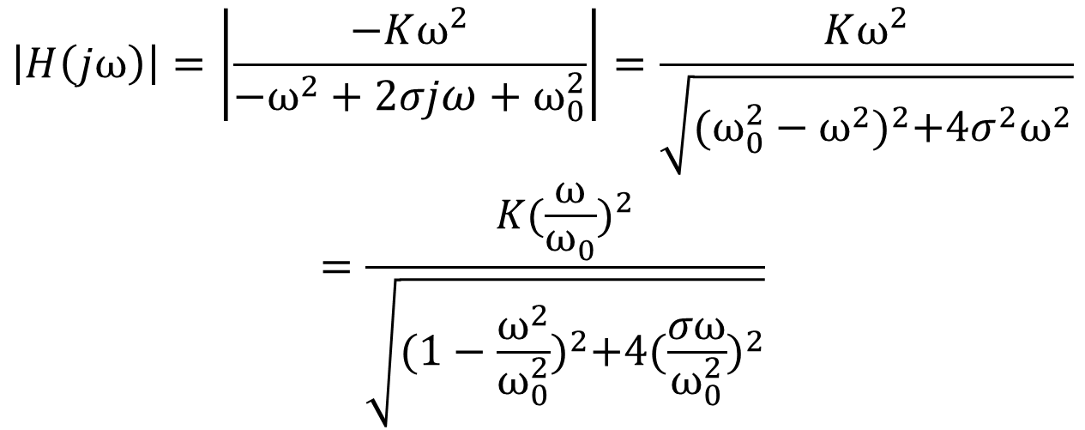
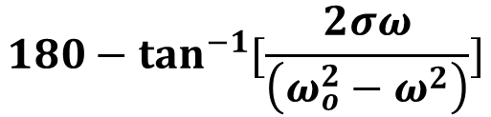
The gain (amplitude) of the frequency response is given by:
$$\left|H\left(jω\right)\right|=\left|\frac{−Kω^{2}}{−ω^{2}+2σjω+ω_{0}^{2}}\right|=\frac{Kω^{2}}{\sqrt{{(ω_{0}^{2}−ω^{2})}^{2}+4σ^{2}ω^{2}}}$$
$$=\frac{K(\frac{ω}{ω_{0}})^{2}}{\sqrt{{(1−\frac{ω^{2}}{ω_{0}^{2}})}^{2}+4{(\frac{σω}{ω_{0}^{2}})}^{2}}}$$
The phase response is given by:
$${180−tan}^{−1}{[\frac{2σω}{\left(ω_{o}^{2}−ω^{2}\right)}]}$$

Slide 10
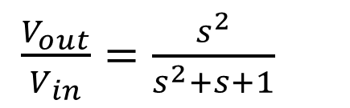
Example
1- Find the transfer function of the shown circuit.
2- What kind of filter does this circuit represent.
3-Find the peak frequency (w_{o}) and the gain factor “K”.
${Consider Z}_{in}=\frac{1}{sc}=\frac{1}{s}$, and $Z_{out}=sL||1=s||1=\frac{S}{S+1}$
Then the TF will be: $\frac{V_{out}}{V_{in}}=\frac{Z_{out}}{Z_{in}+Z_{out}}=\frac{\frac{s}{s+1}}{\frac{1}{s}+\frac{s}{s+1}}=\frac{\frac{s}{s+1}}{\frac{s+1}{s(s+1)}+\frac{s×s}{s(s+1)}}=\frac{\frac{s}{s+1}}{\frac{s^{2}+s+1}{s(s+1)}}=\frac{s^{2}}{s^{2}+s+1}$
There is an “$s^{2}$” on the numerator, then this is a High Pass Filter.
By matching the below 2 equations, we can easily find $ω_{0}$=1, and K =1
$\frac{V_{out}}{V_{in}}=\frac{s^{2}}{s^{2}+s+1}$
&

Slide 11
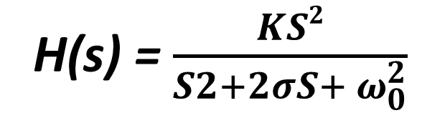
salman
Example
1- Find the transfer function of the shown circuit.
2- What kind of filter does this circuit represent.
3-Find the peak frequency (w_{o}) and the gain factor “K”.
${Consider Z}_{in}=\frac{1}{sc}=\frac{1}{s}$, and $Z_{out}=sL||1=s||1=\frac{S}{S+1}$
Then the TF will be: $\frac{V_{out}}{V_{in}}=\frac{Z_{out}}{Z_{in}+Z_{out}}=\frac{\frac{s}{s+1}}{\frac{1}{s}+\frac{s}{s+1}}=\frac{\frac{s}{s+1}}{\frac{s+1}{s(s+1)}+\frac{s×s}{s(s+1)}}=\frac{\frac{s}{s+1}}{\frac{s^{2}+s+1}{s(s+1)}}=\frac{s^{2}}{s^{2}+s+1}$
There is an “$s^{2}$” on the numerator, then this is a High Pass Filter.
By matching the below 2 equations, we can easily find $ω_{0}$=1, and K =1
H(s) = $\frac{KS2}{S2+2σS+ ω_{0}^{2}}$
$\frac{V_{out}}{V_{in}}=\frac{s^{2}}{s^{2}+s+1}$
&

Slide 12
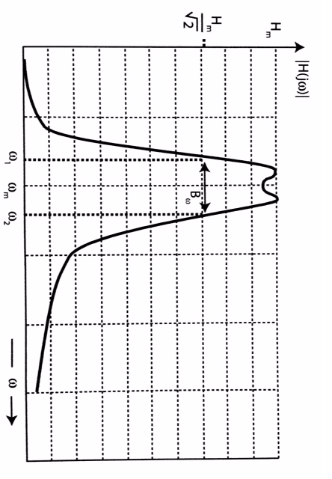
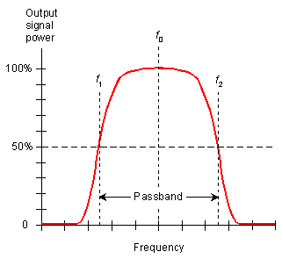
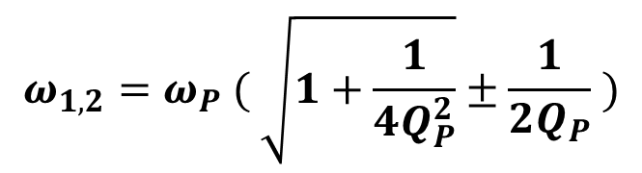

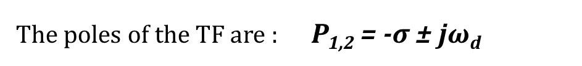
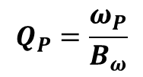

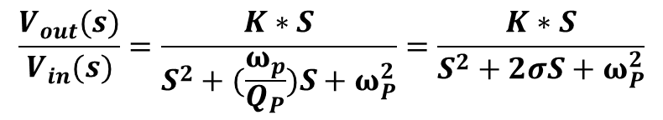
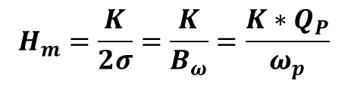

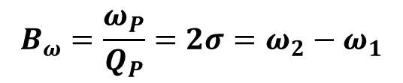

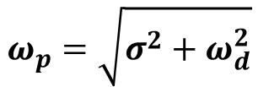
Band Pass (BP) Filter
$$ω_{p}$$
The general TF of a 2nd order BPF
$$ω_{1}$$
$$ω_{2}$$
$$\frac{V_{out}(s)}{V_{in}(s)}=\frac{K∗S}{S^{2}+(\frac{ω_{p}}{Q_{P}})S+ω_{P}^{2}}=\frac{K∗S}{S^{2}+2σS+ω_{P}^{2}}$$
The poles of the TF are : P_{1,2} = -σ ± j$ω$_{d}
$$ω_{p}=\sqrt{σ^{2}+ω_{d}^{2}}$$
The peak frequency is :
$$B_{ω}=\frac{ω_{P}}{Q_{P}}=2σ=ω_{2}−ω_{1}$$
$$ω (rad/sec)$$
The Bandwidth is :
$$ω_{1,2}=ω_{P} ( \sqrt{1+\frac{1}{4Q_{P}^{2}}}±\frac{1}{2Q_{P}} )$$
$$H_{m}=\frac{K}{2σ}=\frac{K}{B_{ω}}=\frac{K∗Q_{P}}{ω_{p}}$$
The maximum value:
The Quality factor:
$$Q_{P}=\frac{ω_{P}}{B_{ω}}$$

Slide 13
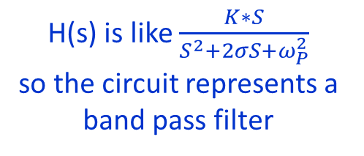
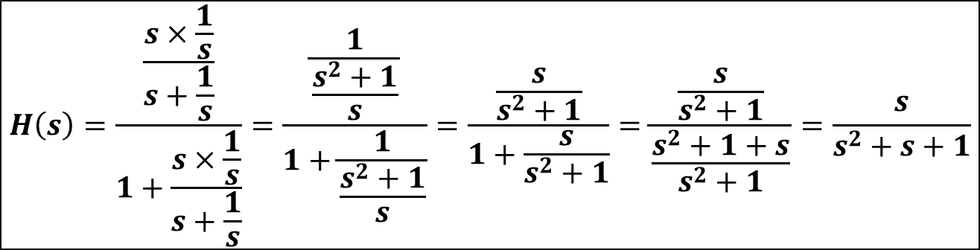
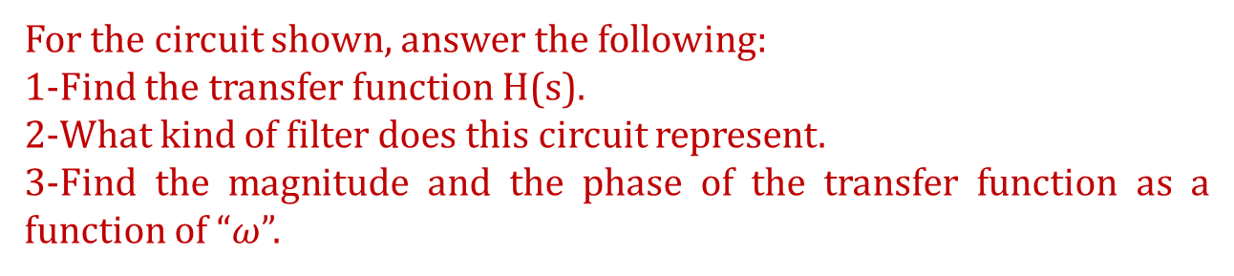
Example -1
For the circuit shown, answer the following:
1-Find the transfer function H(s).
2-What kind of filter does this circuit represent.
3-Find the magnitude and the phase of the transfer function as a function of “$ω$”.
Solution
$$H\left(s\right)=\frac{\frac{s×\frac{1}{s}}{s+\frac{1}{s}}}{1+\frac{s×\frac{1}{s}}{s+\frac{1}{s}}}=\frac{\frac{1}{\frac{s^{2}+1}{s}}}{1+\frac{1}{\frac{s^{2}+1}{s}}}=\frac{\frac{s}{s^{2}+1}}{1+\frac{s}{s^{2}+1}}=\frac{\frac{s}{s^{2}+1}}{\frac{s^{2}+1+s}{s^{2}+1}}=\frac{s}{s^{2}+s+1}$$
H(s) is like $\frac{K∗S}{S^{2}+2σS+ω_{P}^{2}}$
so the circuit represents a
band pass filter

Slide 14
Example -1
For the circuit shown, answer the following:
1-Find the transfer function H(s).
2-What kind of filter does this circuit represent.
3-Find the magnitude and the phase of the transfer function as a function of “$ω$”.
Solution
$$H\left(s\right)=\frac{\frac{s×\frac{1}{s}}{s+\frac{1}{s}}}{1+\frac{s×\frac{1}{s}}{s+\frac{1}{s}}}=\frac{\frac{1}{\frac{s^{2}+1}{s}}}{1+\frac{1}{\frac{s^{2}+1}{s}}}=\frac{\frac{s}{s^{2}+1}}{1+\frac{s}{s^{2}+1}}=\frac{\frac{s}{s^{2}+1}}{\frac{s^{2}+1+s}{s^{2}+1}}=\frac{s}{s^{2}+s+1}$$
H(s) is like $\frac{K∗S}{S^{2}+2σS+ω_{P}^{2}}$
so the circuit represents a
band pass filter

Slide 15
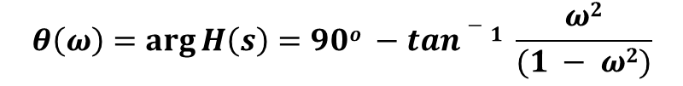
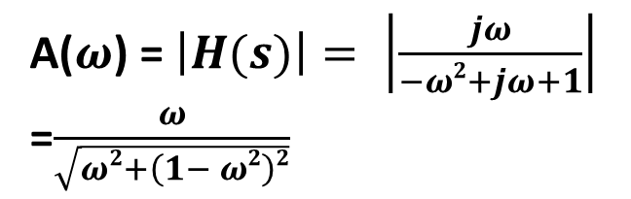
salman
Example -1
For the circuit shown, answer the following:
1-Find the transfer function H(s).
2-What kind of filter does this circuit represent.
3-Find the magnitude and the phase of the transfer function as a function of “$ω$”.
Solution
$$H\left(s\right)=\frac{\frac{s×\frac{1}{s}}{s+\frac{1}{s}}}{1+\frac{s×\frac{1}{s}}{s+\frac{1}{s}}}=\frac{\frac{1}{\frac{s^{2}+1}{s}}}{1+\frac{1}{\frac{s^{2}+1}{s}}}=\frac{\frac{s}{s^{2}+1}}{1+\frac{s}{s^{2}+1}}=\frac{\frac{s}{s^{2}+1}}{\frac{s^{2}+1+s}{s^{2}+1}}=\frac{s}{s^{2}+s+1}$$
H(s) is like $\frac{K∗S}{S^{2}+2σS+ω_{P}^{2}}$
so the circuit represents a
band pass filter
A($ω$) = $\left|H(s)\right|= \left|\frac{jω}{−ω2+jω+1}\right|$
=$\frac{ω}{\sqrt{ω2+\left(1− ω2\right)2}}$
$$θ\left(ω\right)=\arg{H\left(s\right)=90o −tan−1 \frac{ω2}{(1 − ω2)}}$$

Slide 16
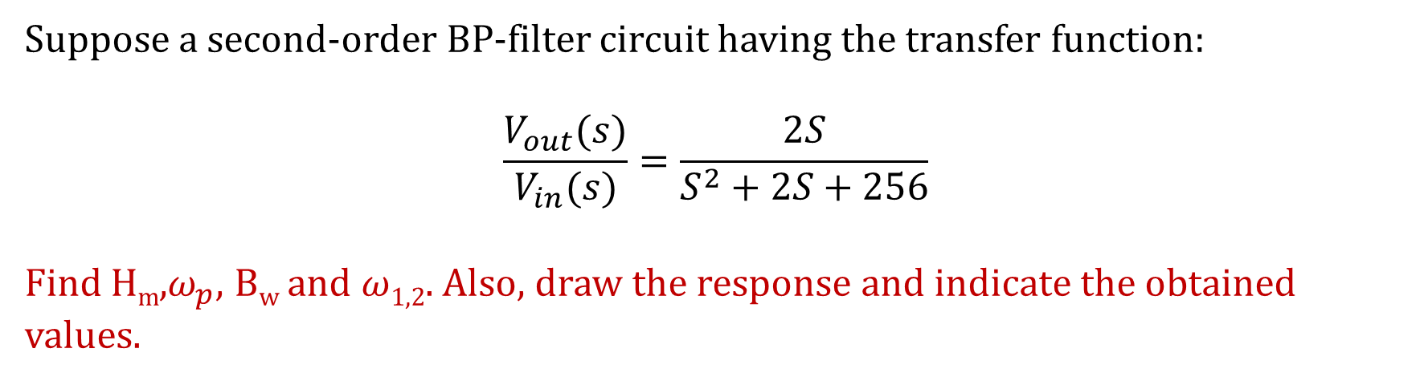
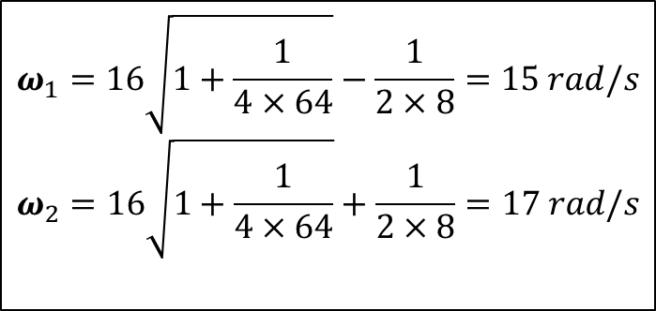
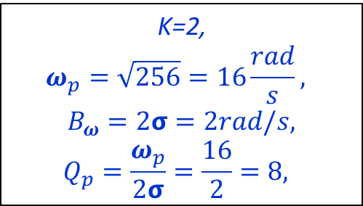
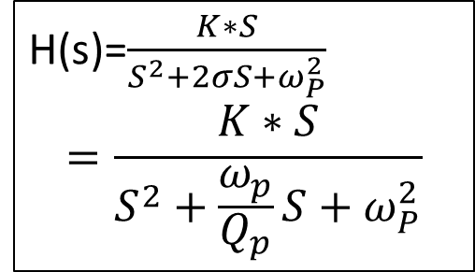
Example -2
Suppose a second-order BP-filter circuit having the transfer function:
$$\frac{V_{out}(s)}{V_{in}(s)}=\frac{2S}{S^{2}+2S+256}$$
Find H_{m},$ω_{p}$, B_{w} and $ω$_{1,2}. Also, draw the response and indicate the obtained values.
H(s)=$\frac{K∗S}{S^{2}+2σS+ω_{P}^{2}}$
$$=\frac{K∗S}{S^{2}+\frac{ω_{p}}{Q_{p}}S+ω_{P}^{2}}$$
K=2,
$$ω_{p}=\sqrt{256}=16\frac{rad}{s},$$
$B_{ω}=2σ=2rad/s,$
$$Q_{p}=\frac{ω_{p}}{2σ}=\frac{16}{2}=8,$$
$$ω_{1}=16\sqrt{1+\frac{1}{4×64}}−\frac{1}{2×8}=15 rad/s$$
$$ω_{2}=16\sqrt{1+\frac{1}{4×64}}+\frac{1}{2×8}=17 rad/s$$
$ω$_{p}=16 rad/sec, B_{W}=2 rad/sec, H_{m}=1, $ω$₁=15 rad/sec and $ω$₂=17 rad/sec.

Slide 17
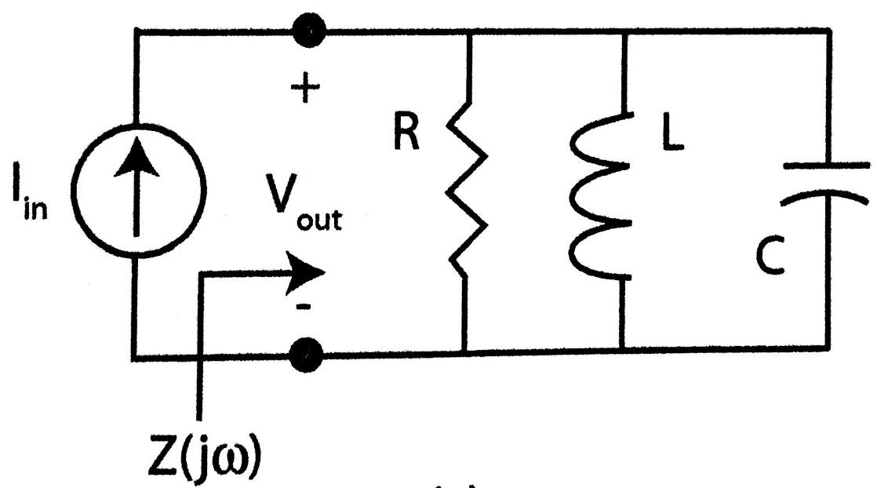
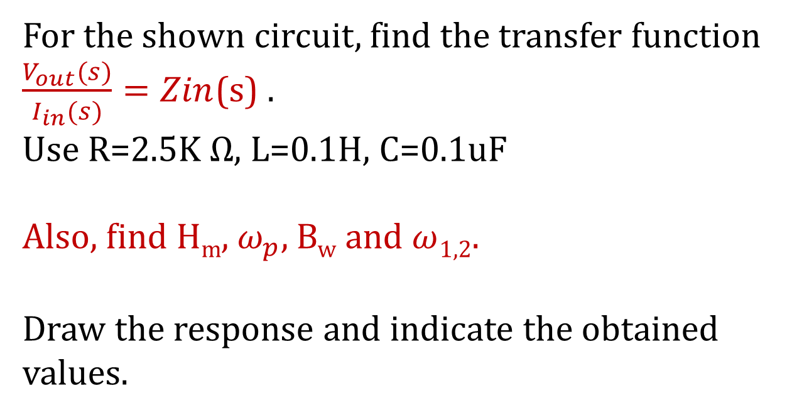
Example -3
For the shown circuit, find the transfer function $\frac{V_{out}(s)}{I_{in}(s)}=Zin$(s) .
Use R=2.5K Ω, L=0.1H, C=0.1uF
Also, find H_{m}, $ω_{p}$, B_{w} and $ω$_{1,2}.
Draw the response and indicate the obtained values.

Slide 18
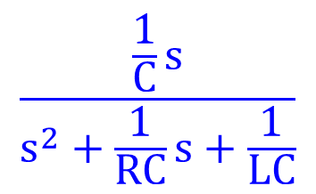
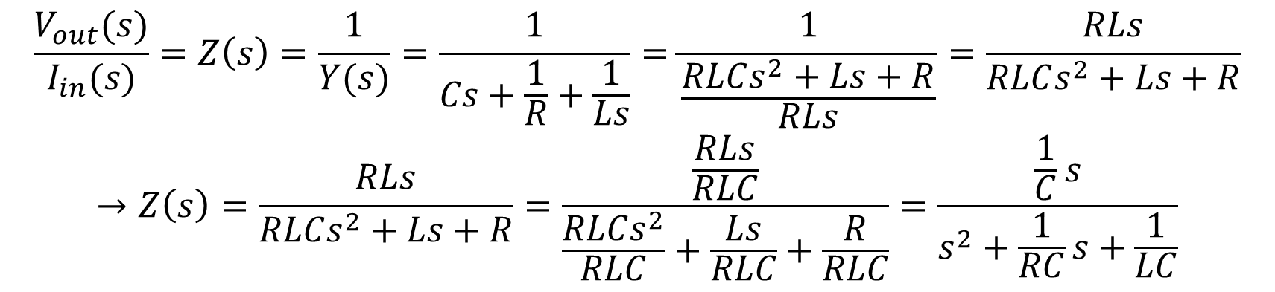
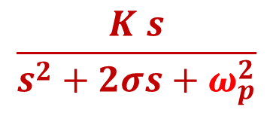
Example -3
$$\frac{V_{out}(s)}{I_{in}(s)}=Z\left(s\right)=\frac{1}{Y(s)}=\frac{1}{Cs+\frac{1}{R}+\frac{1}{Ls}}=\frac{1}{\frac{RLCs^{2}+Ls+R}{RLs}}=\frac{RLs}{RLCs^{2}+Ls+R}$$
$$→Z\left(s\right)=\frac{RLs}{RLCs^{2}+Ls+R}=\frac{\frac{RLs}{RLC}}{\frac{RLCs^{2}}{RLC}+\frac{Ls}{RLC}+\frac{R}{RLC}}=\frac{\frac{1}{C}s}{s^{2}+\frac{1}{RC}s+\frac{1}{LC}}$$
$$\frac{\frac{1}{C}s}{s^{2}+\frac{1}{RC}s+\frac{1}{LC}}$$
Compare this equation:
$$\frac{K s}{s^{2}+2σs+ω_{p}^{2}}$$
With the BPF equation:

Slide 19
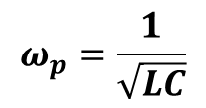
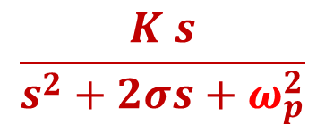
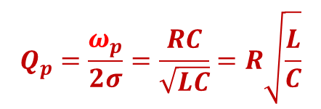
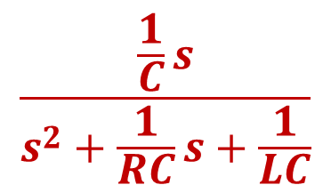
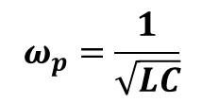
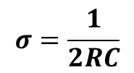
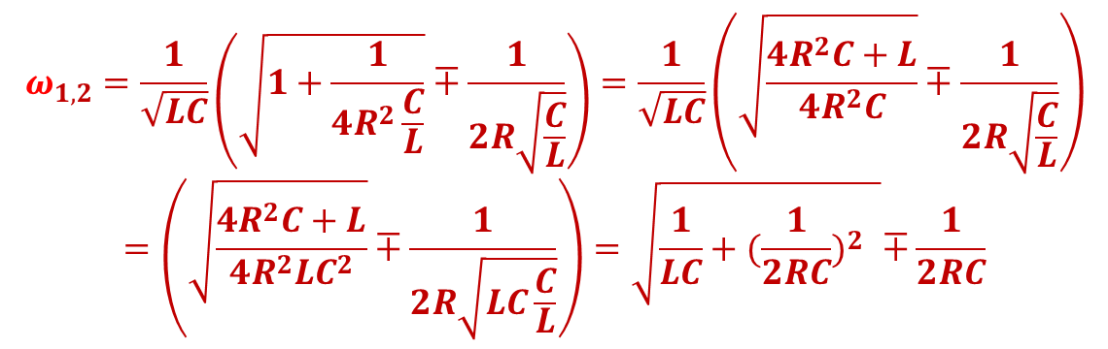
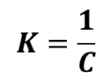
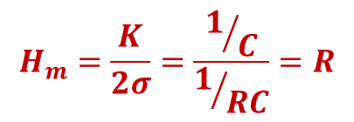
$$σ=\frac{1}{2RC}$$
Example 3
$$Q_{p}=\frac{ω_{p}}{2σ}=\frac{RC}{\sqrt{LC}}=R\sqrt{\frac{L}{C}}$$
$$ω_{p}=\frac{1}{\sqrt{LC}}$$
$$ω_{p}=\frac{1}{\sqrt{LC}}$$
$$\frac{\frac{1}{C}s}{s^{2}+\frac{1}{RC}s+\frac{1}{LC}}$$
Now, replace each parameter
with its value in the example.
$$K=\frac{1}{C}$$
$$H_{m}=\frac{K}{2σ}=\frac{1/C}{1/{RC}}=R$$
$$\frac{K s}{s^{2}+2σs+ω_{p}^{2}}$$
$$ω_{1,2}=\frac{1}{\sqrt{LC}}\left(\sqrt{1+\frac{1}{4R^{2}\frac{C}{L}}}∓\frac{1}{2R\sqrt{\frac{C}{L}}}\right)=\frac{1}{\sqrt{LC}}\left(\sqrt{\frac{4R^{2}C+L}{4R^{2}C}}∓\frac{1}{2R\sqrt{\frac{C}{L}}}\right)$$
$$=\left(\sqrt{\frac{4R^{2}C+L}{4R^{2}LC^{2}}}∓\frac{1}{2R\sqrt{LC\frac{C}{L}}}\right)=\sqrt{\frac{1}{LC}+{(\frac{1}{2RC})}^{2 }}∓\frac{1}{2RC}$$

Slide 20
Answer the following questions using ChatGPT
How do filters affect the amplitude of signals within their pass band and stop band.
Give an example where each filter type might be practically applied in electronic or communication systems
Which property of a filter describes its ability to distinguish between closely spaced frequencies.
Which filter blocks only a specific narrow band of frequencies while passing all others.

Slide 21
.
Summary
Low-Pass Filter (LPF) allows frequencies below the cutoff frequency (f_{c}) to pass and attenuates frequencies above fc. Used to remove high-frequency noise from signals.
High-Pass Filter (HPF) allows frequencies above the cutoff frequency (f_{c}​) to pass, attenuates frequencies below fc, useful in applications that require eliminating low-frequency noise or interference.
Band-Pass Filter (BPF) passes frequencies within a specific range (f_{c​1} to f_{c2}), attenuates frequencies outside this range, and ideal for isolating specific frequency bands.
Notch (Band-Stop) Filter attenuates a narrow band of frequencies, passes frequencies outside this band, used to eliminate unwanted frequencies.
Key Concepts
At cutoff frequency signal amplitude drops to 70.7% (-3 dB).
Pass Band & Stop Band: Frequency ranges that are passed or attenuated by the filter.
Quality Factor (Q) indicates the filter's selectivity and ability to distinguish between frequencies.

